Slide 1
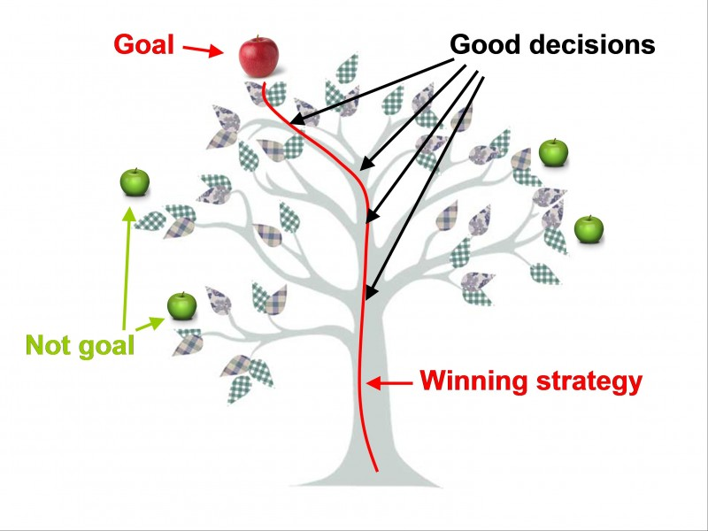
Decision Tree Classifier
https://anyaworksmart.com/
Some slides are taken from http://www.dataminingbook.info/pmwiki.php/Main/BookResources

Slide 2
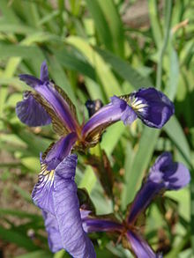
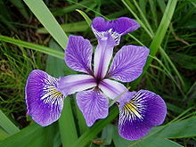
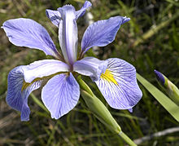
Iris flower data set
The Iris flower data set or Fisher's Iris data set is a multivariate data set introduced by the British statistician and biologist Ronald Fisher in his 1936 paper The use of multiple measurements in taxonomic problems as an example of linear discriminant analysis.
Iris versicolor
Iris virginica
Iris setosa

Slide 3
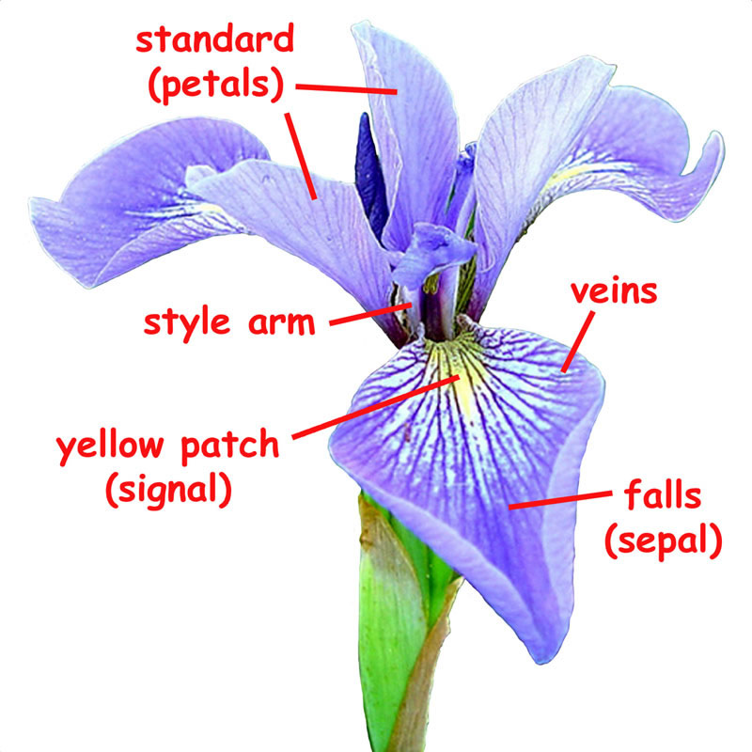
Iris flower

Slide 4
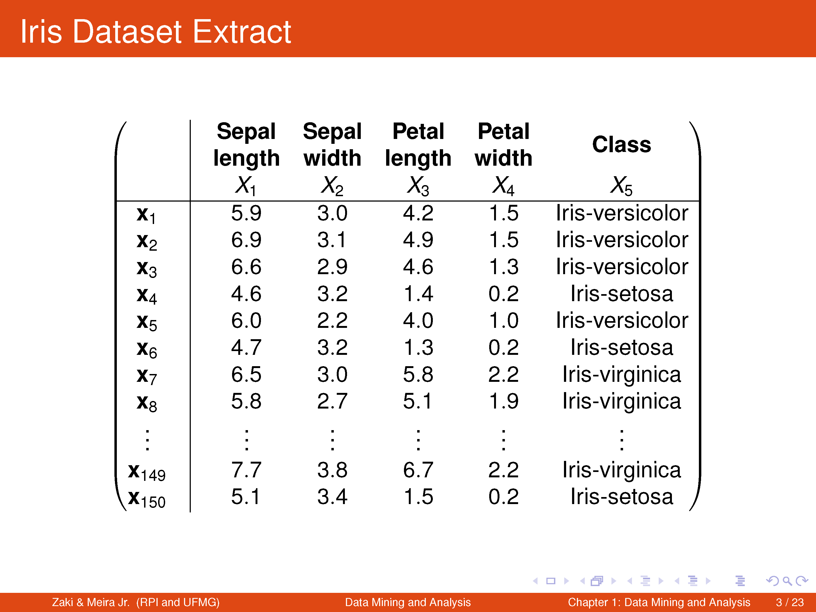

Slide 5
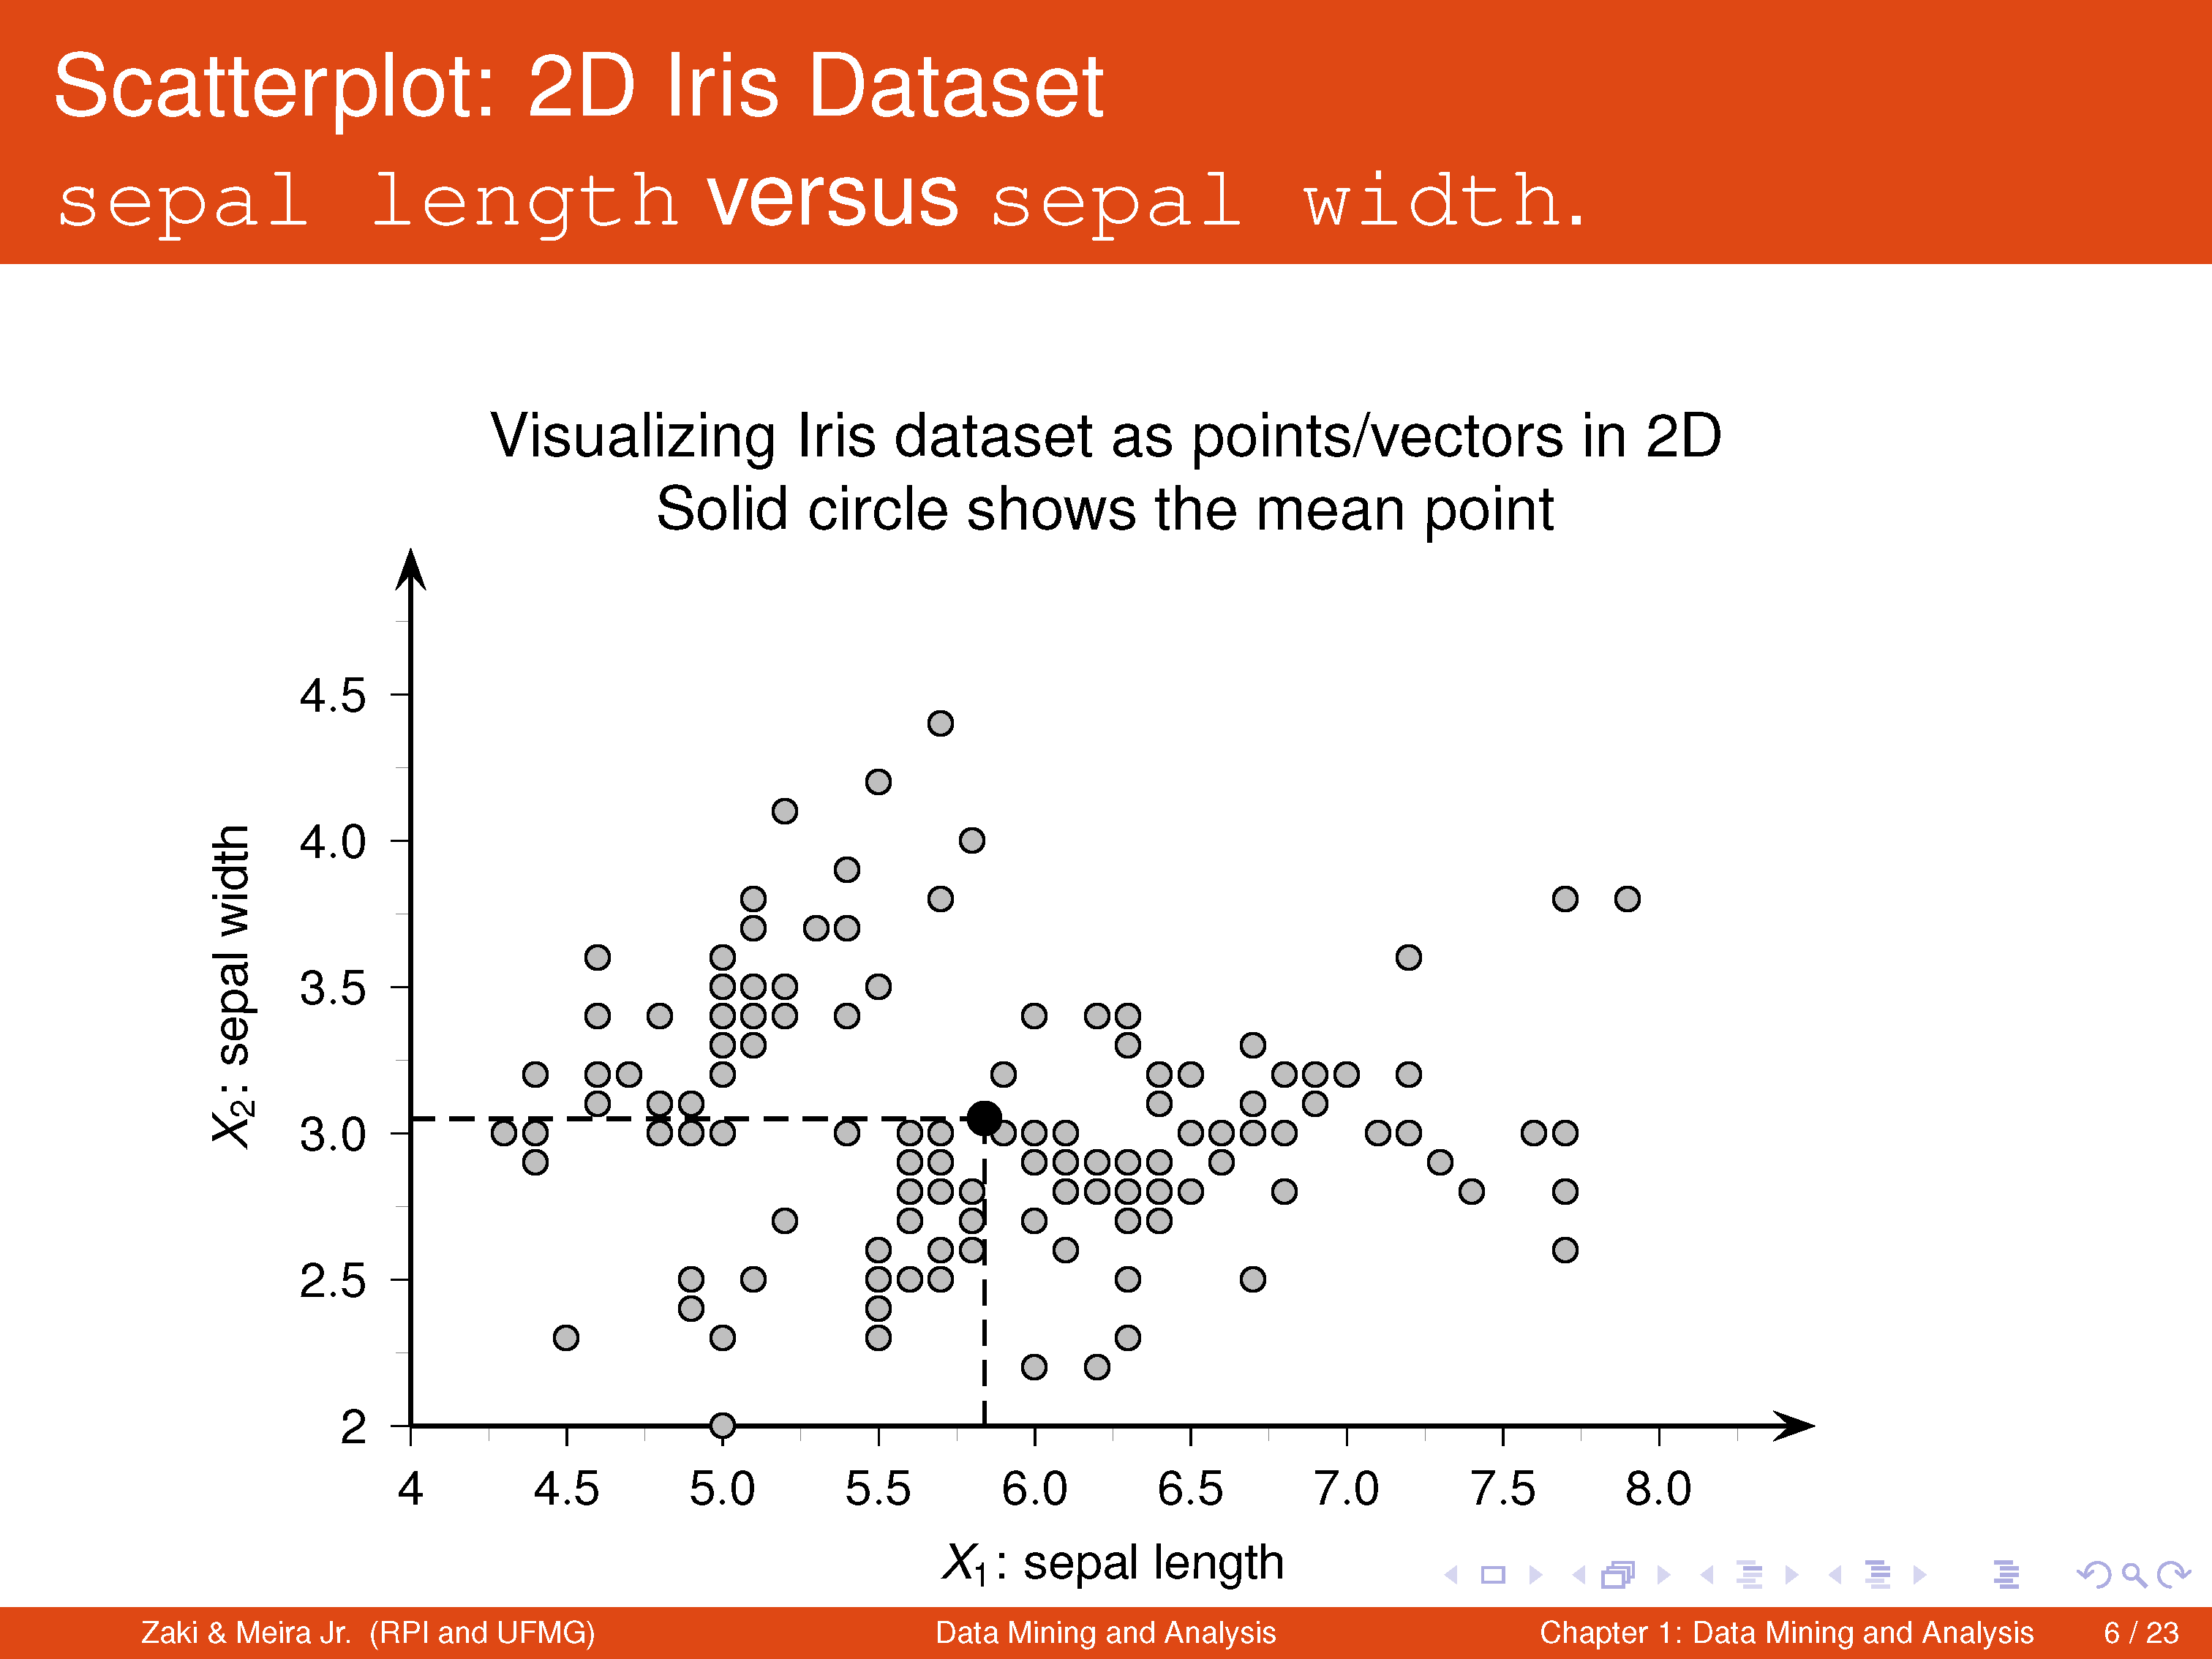

Slide 6
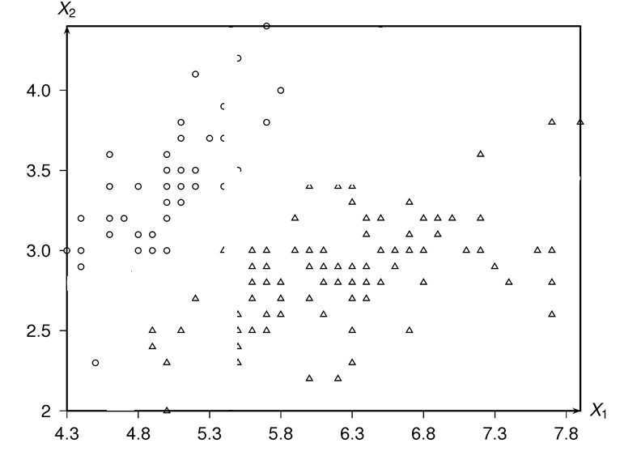

Slide 7
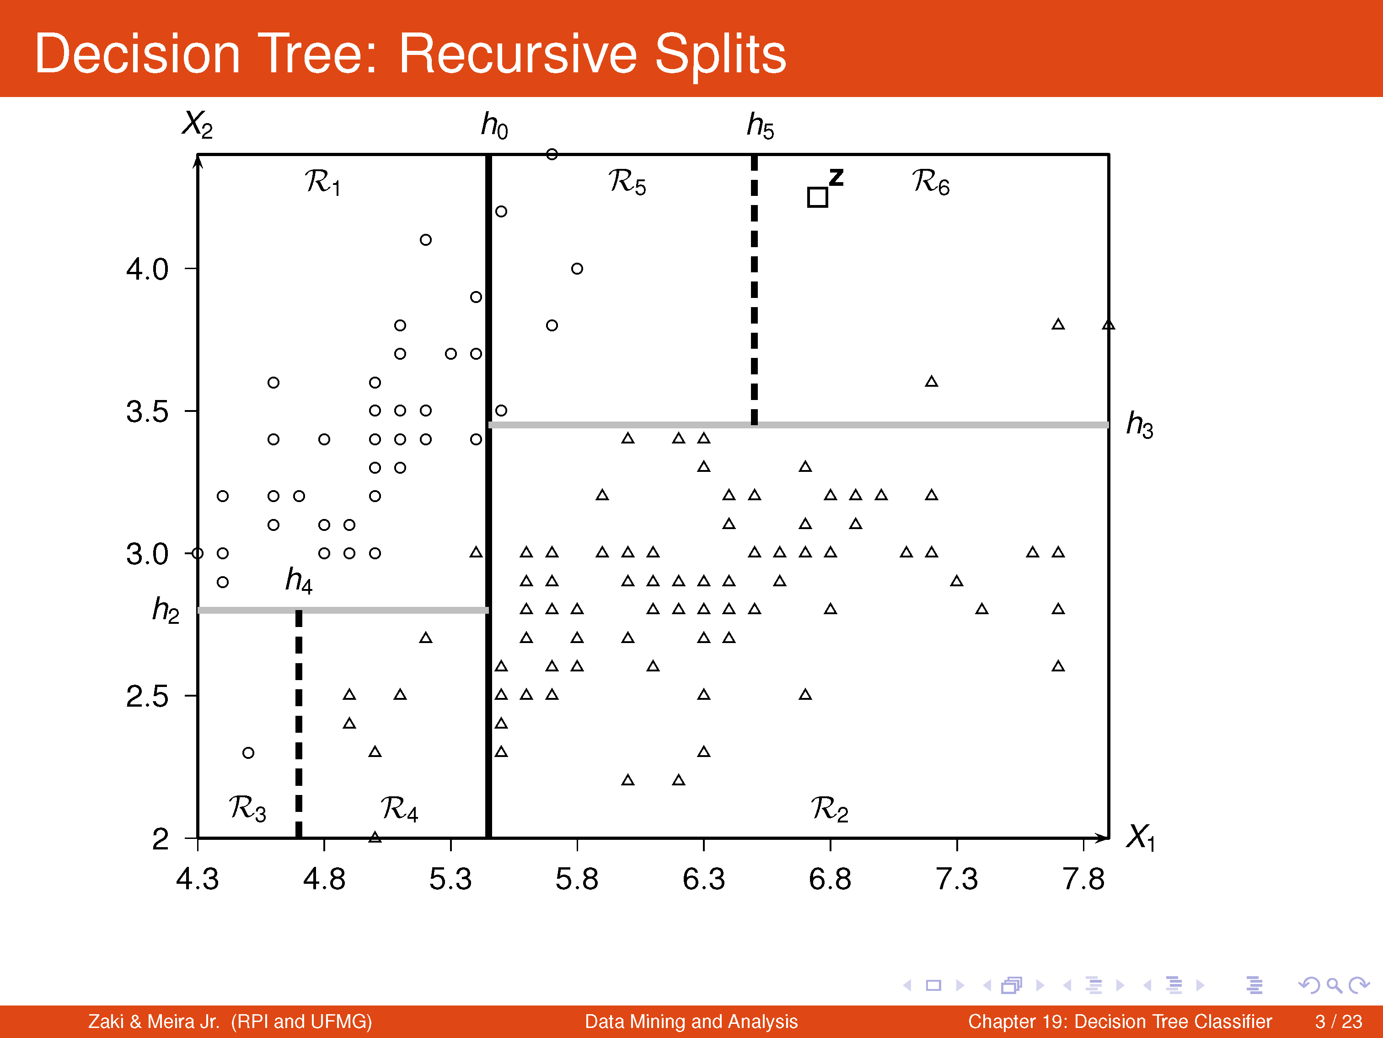

Slide 8
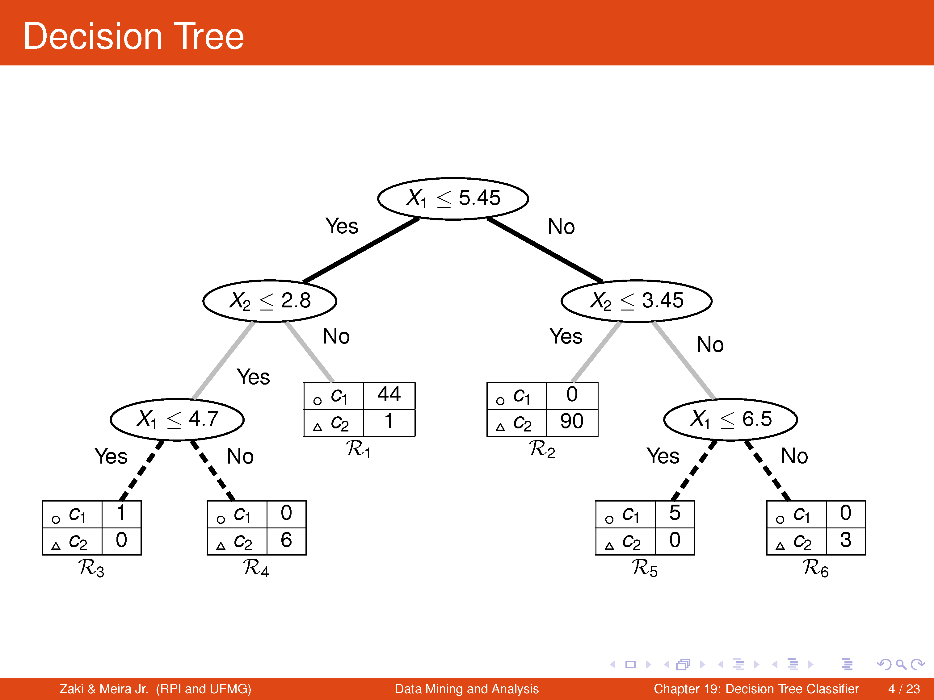

Slide 9
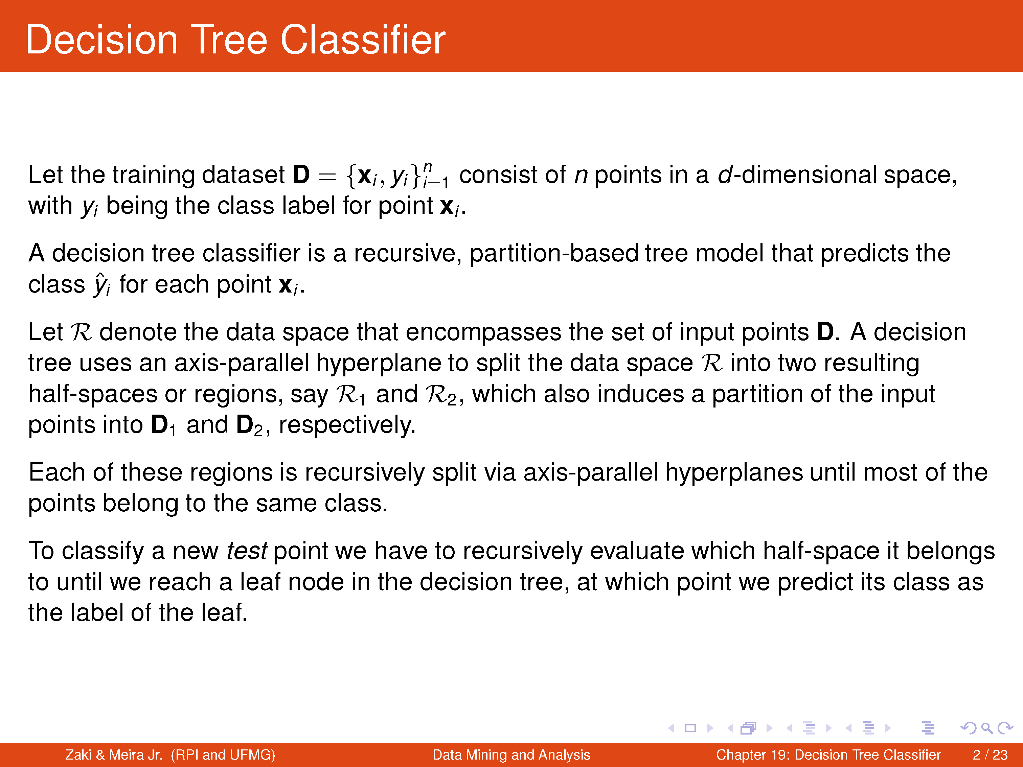

Slide 10
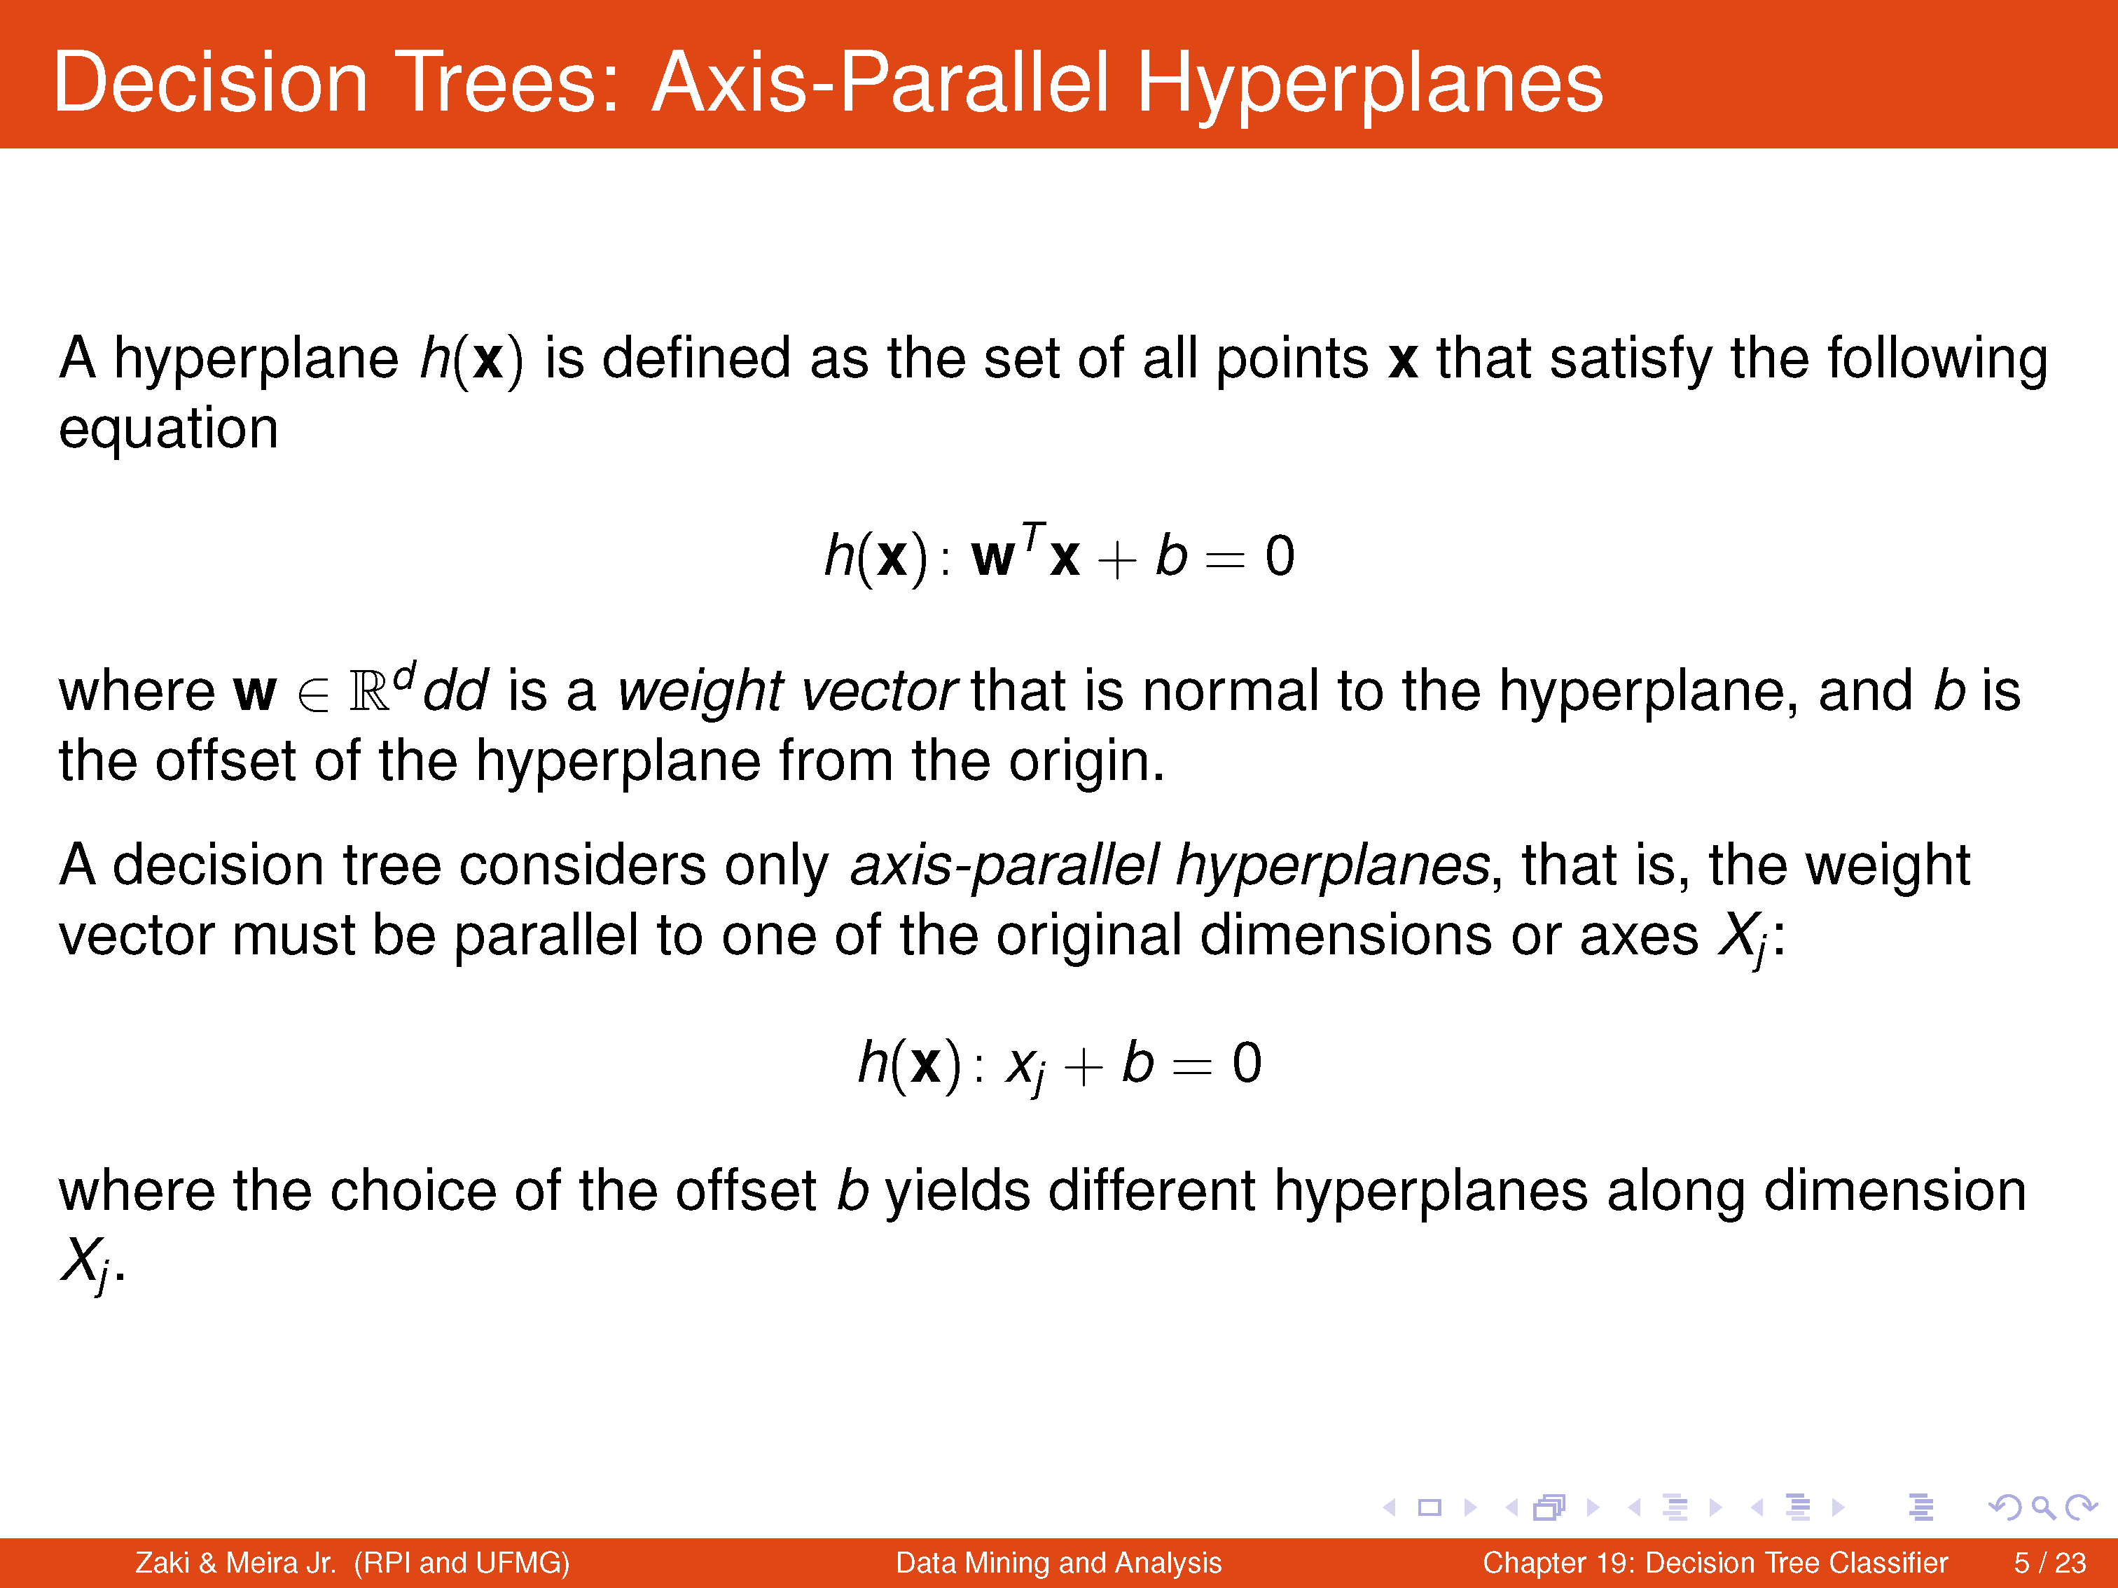

Slide 11
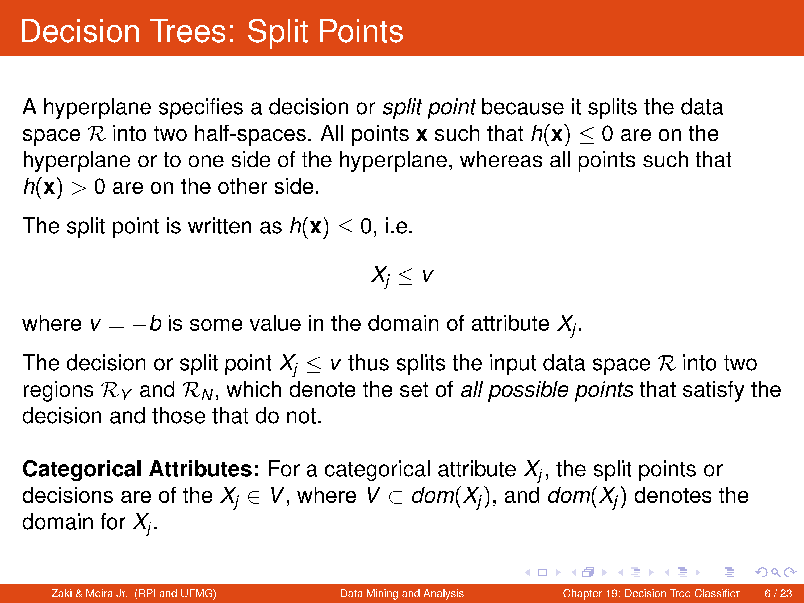

Slide 13
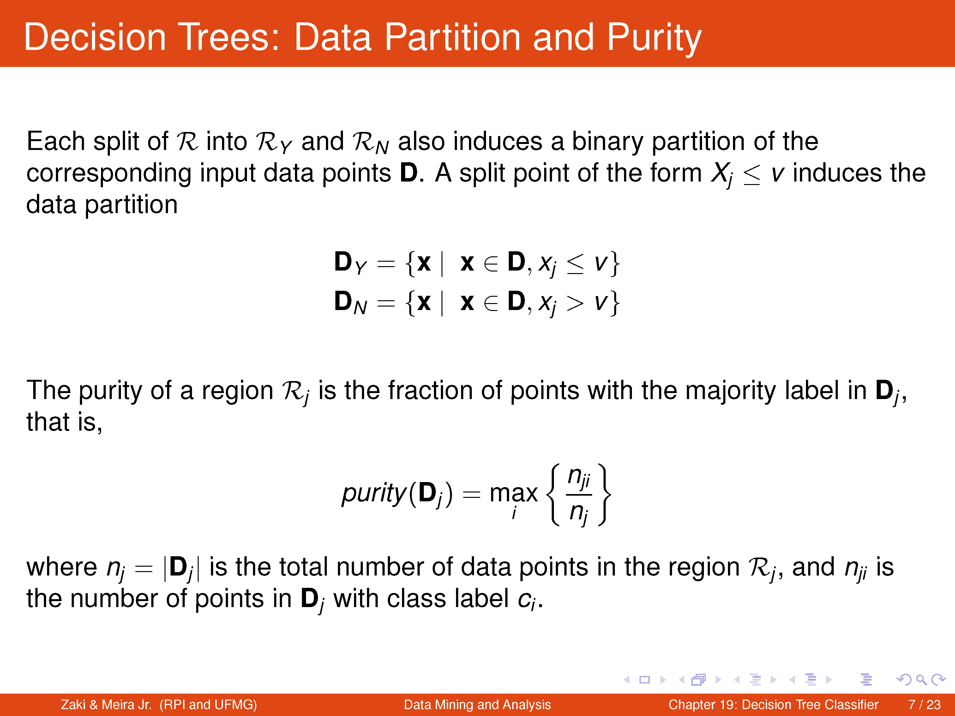

Slide 14
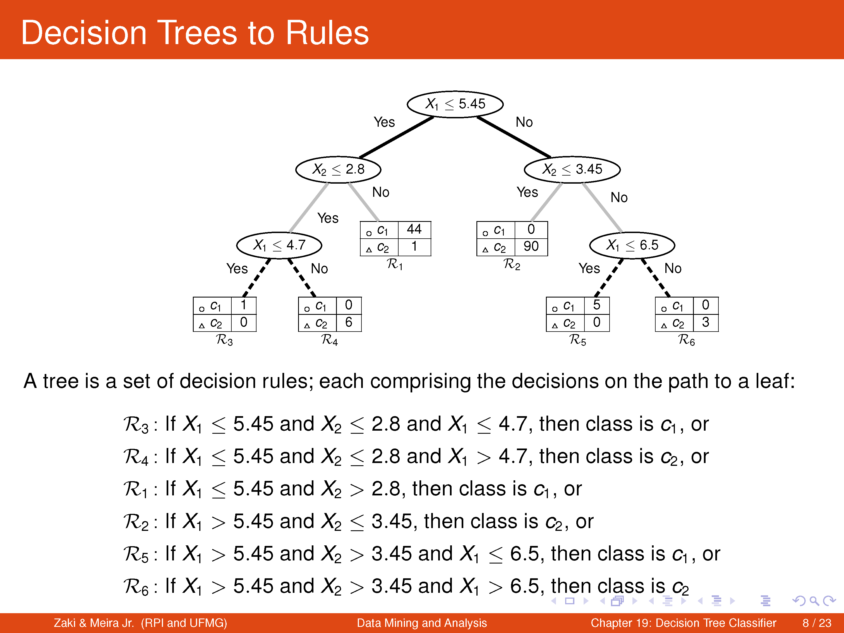

Slide 15
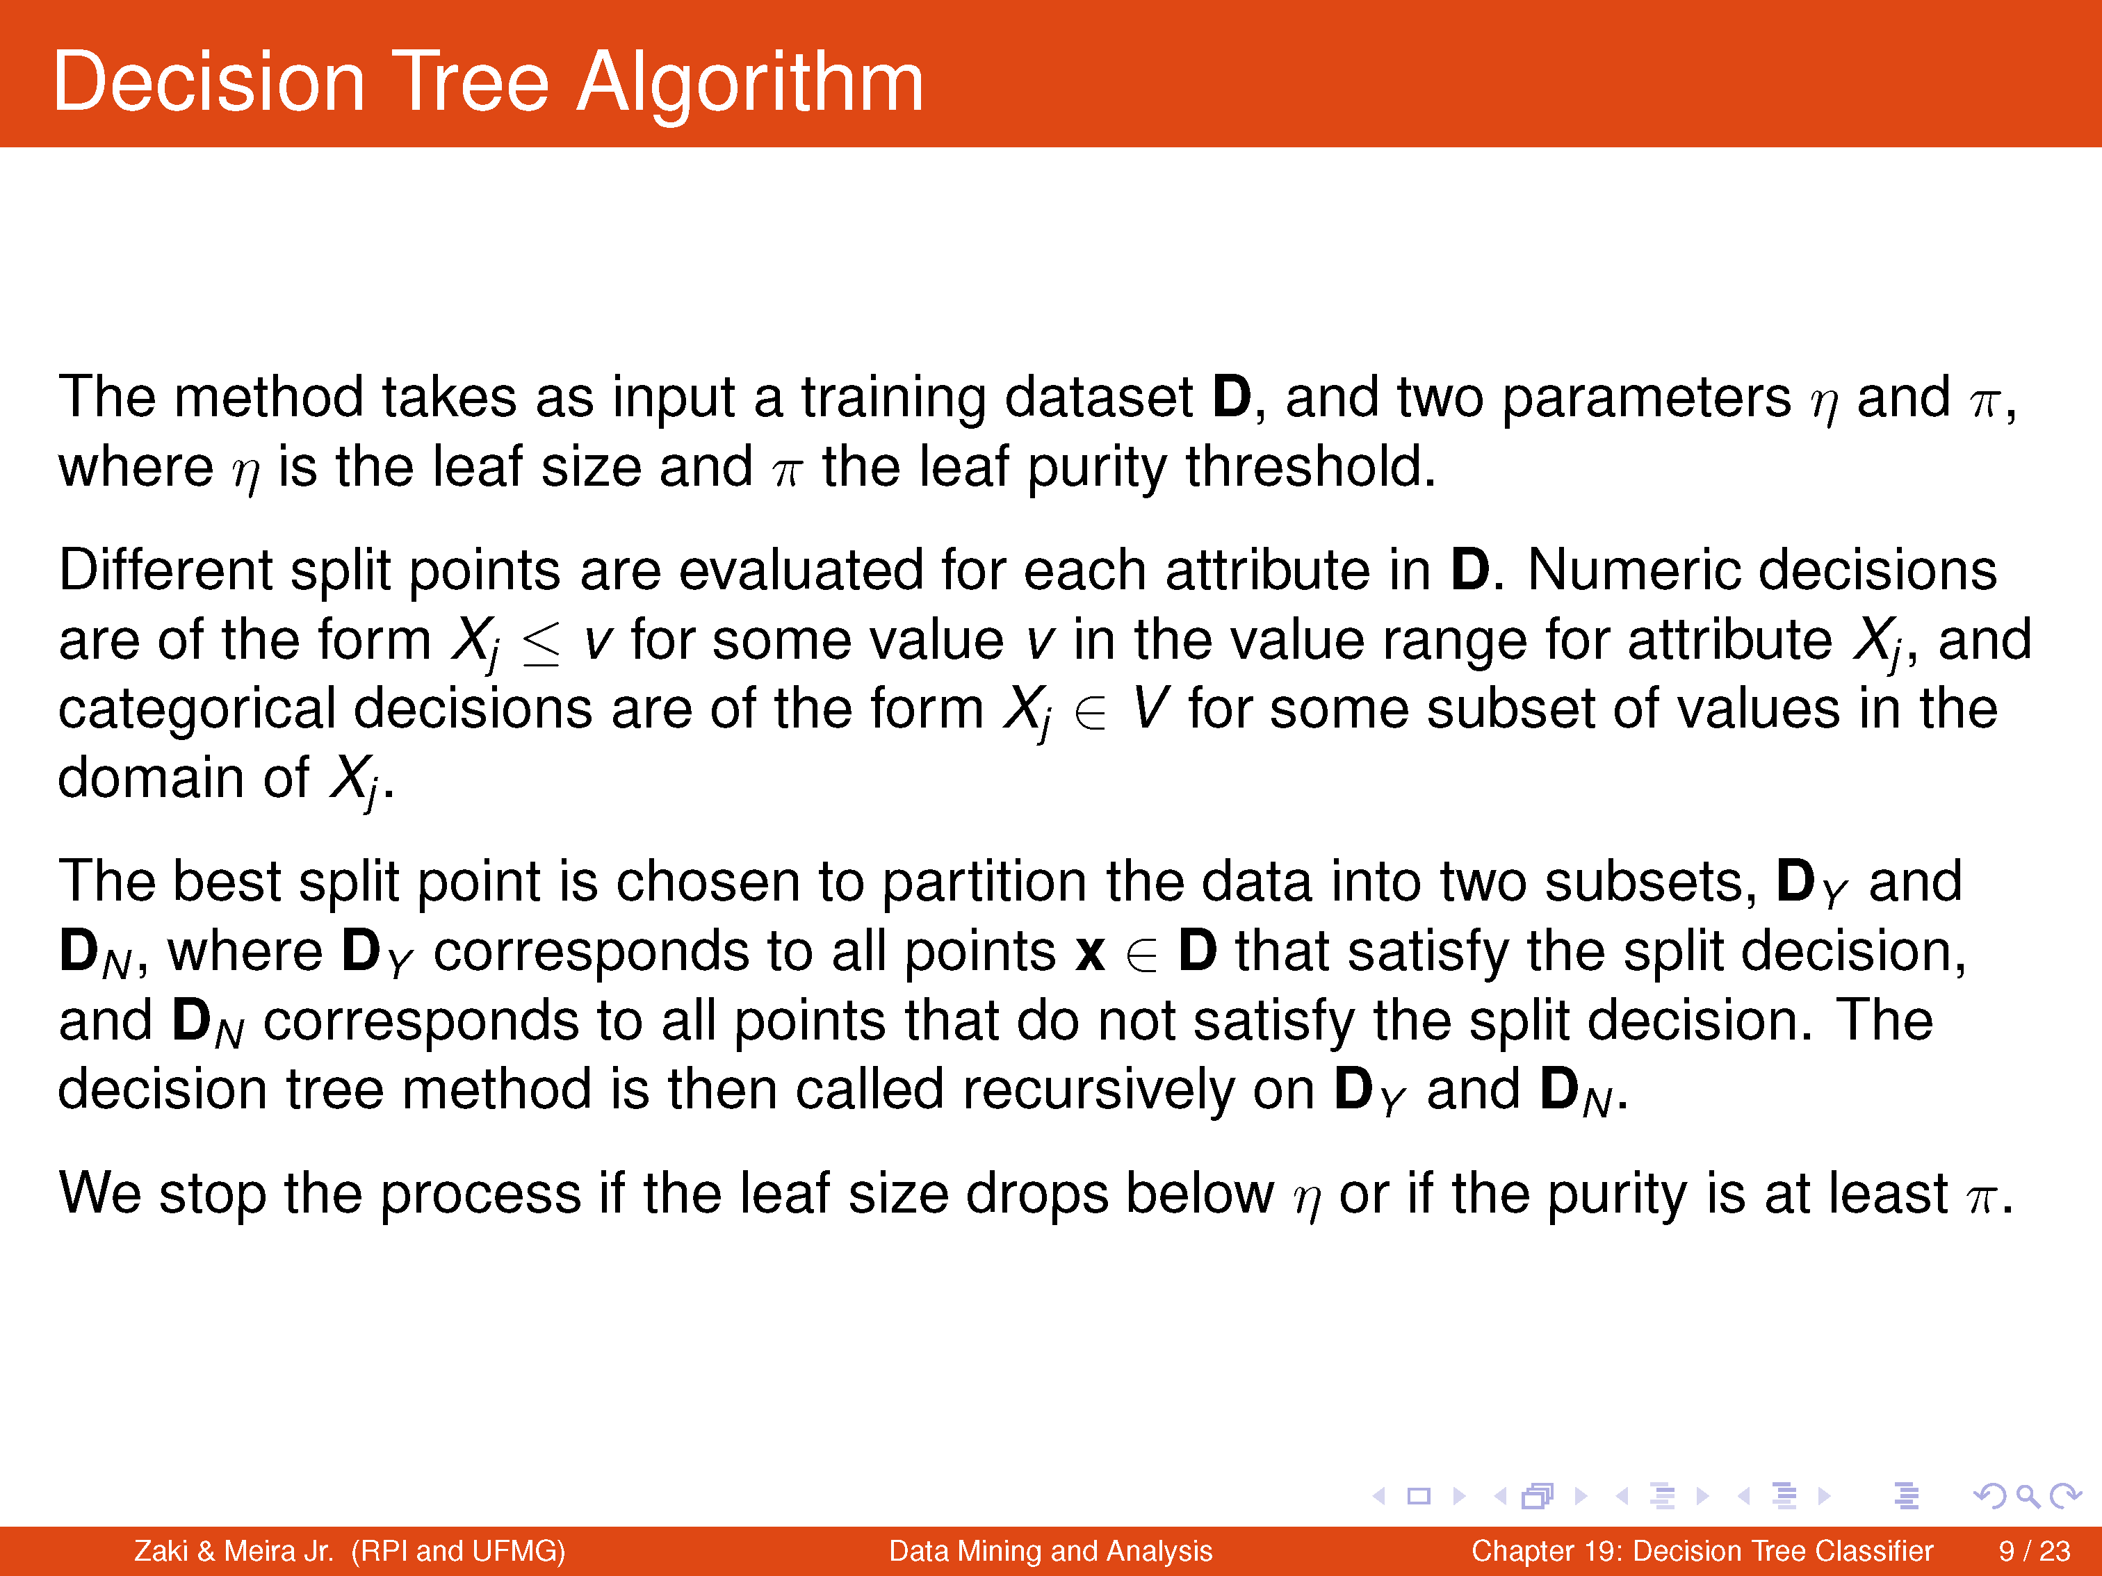

Slide 16
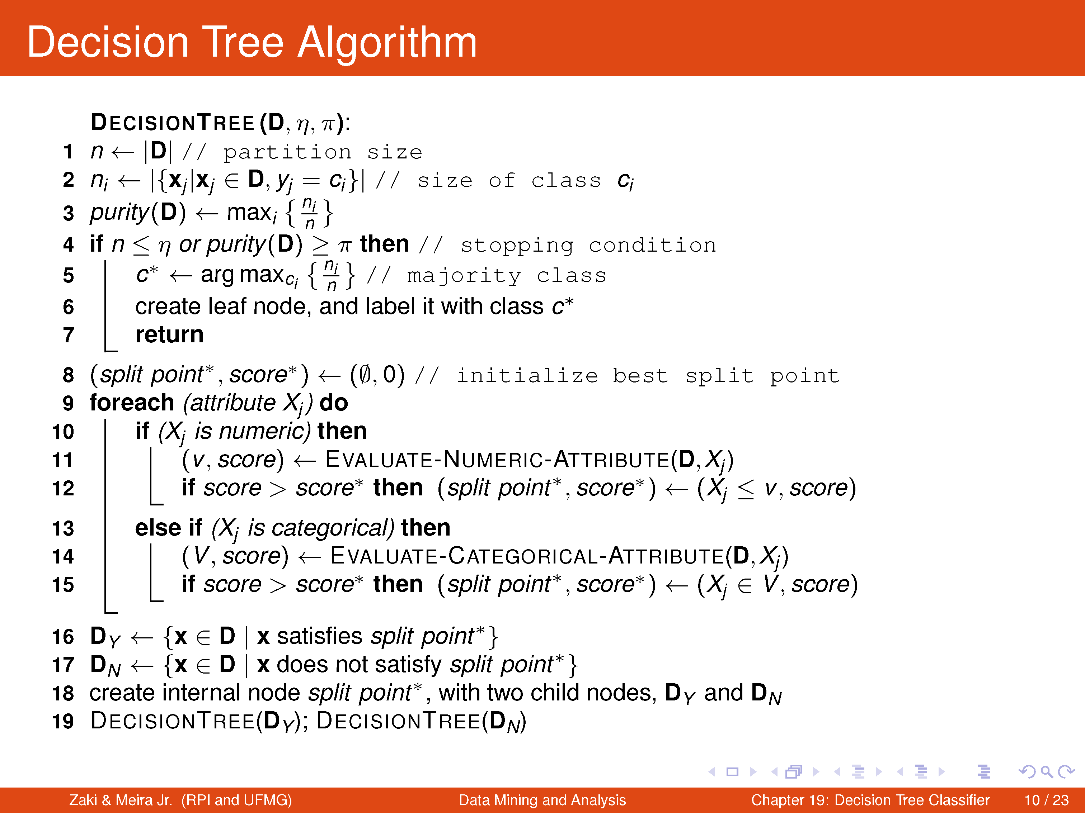

Slide 18
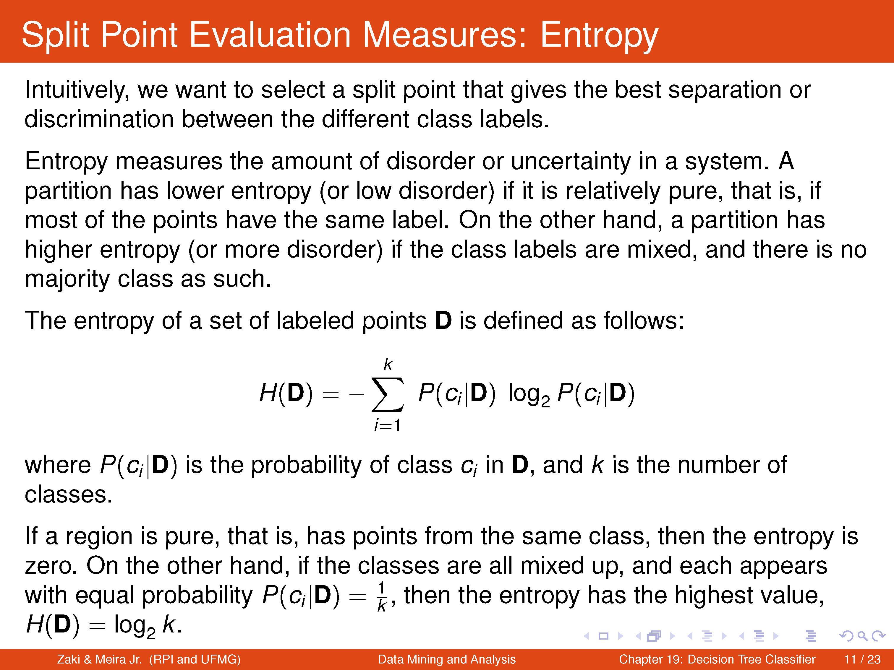

Slide 19
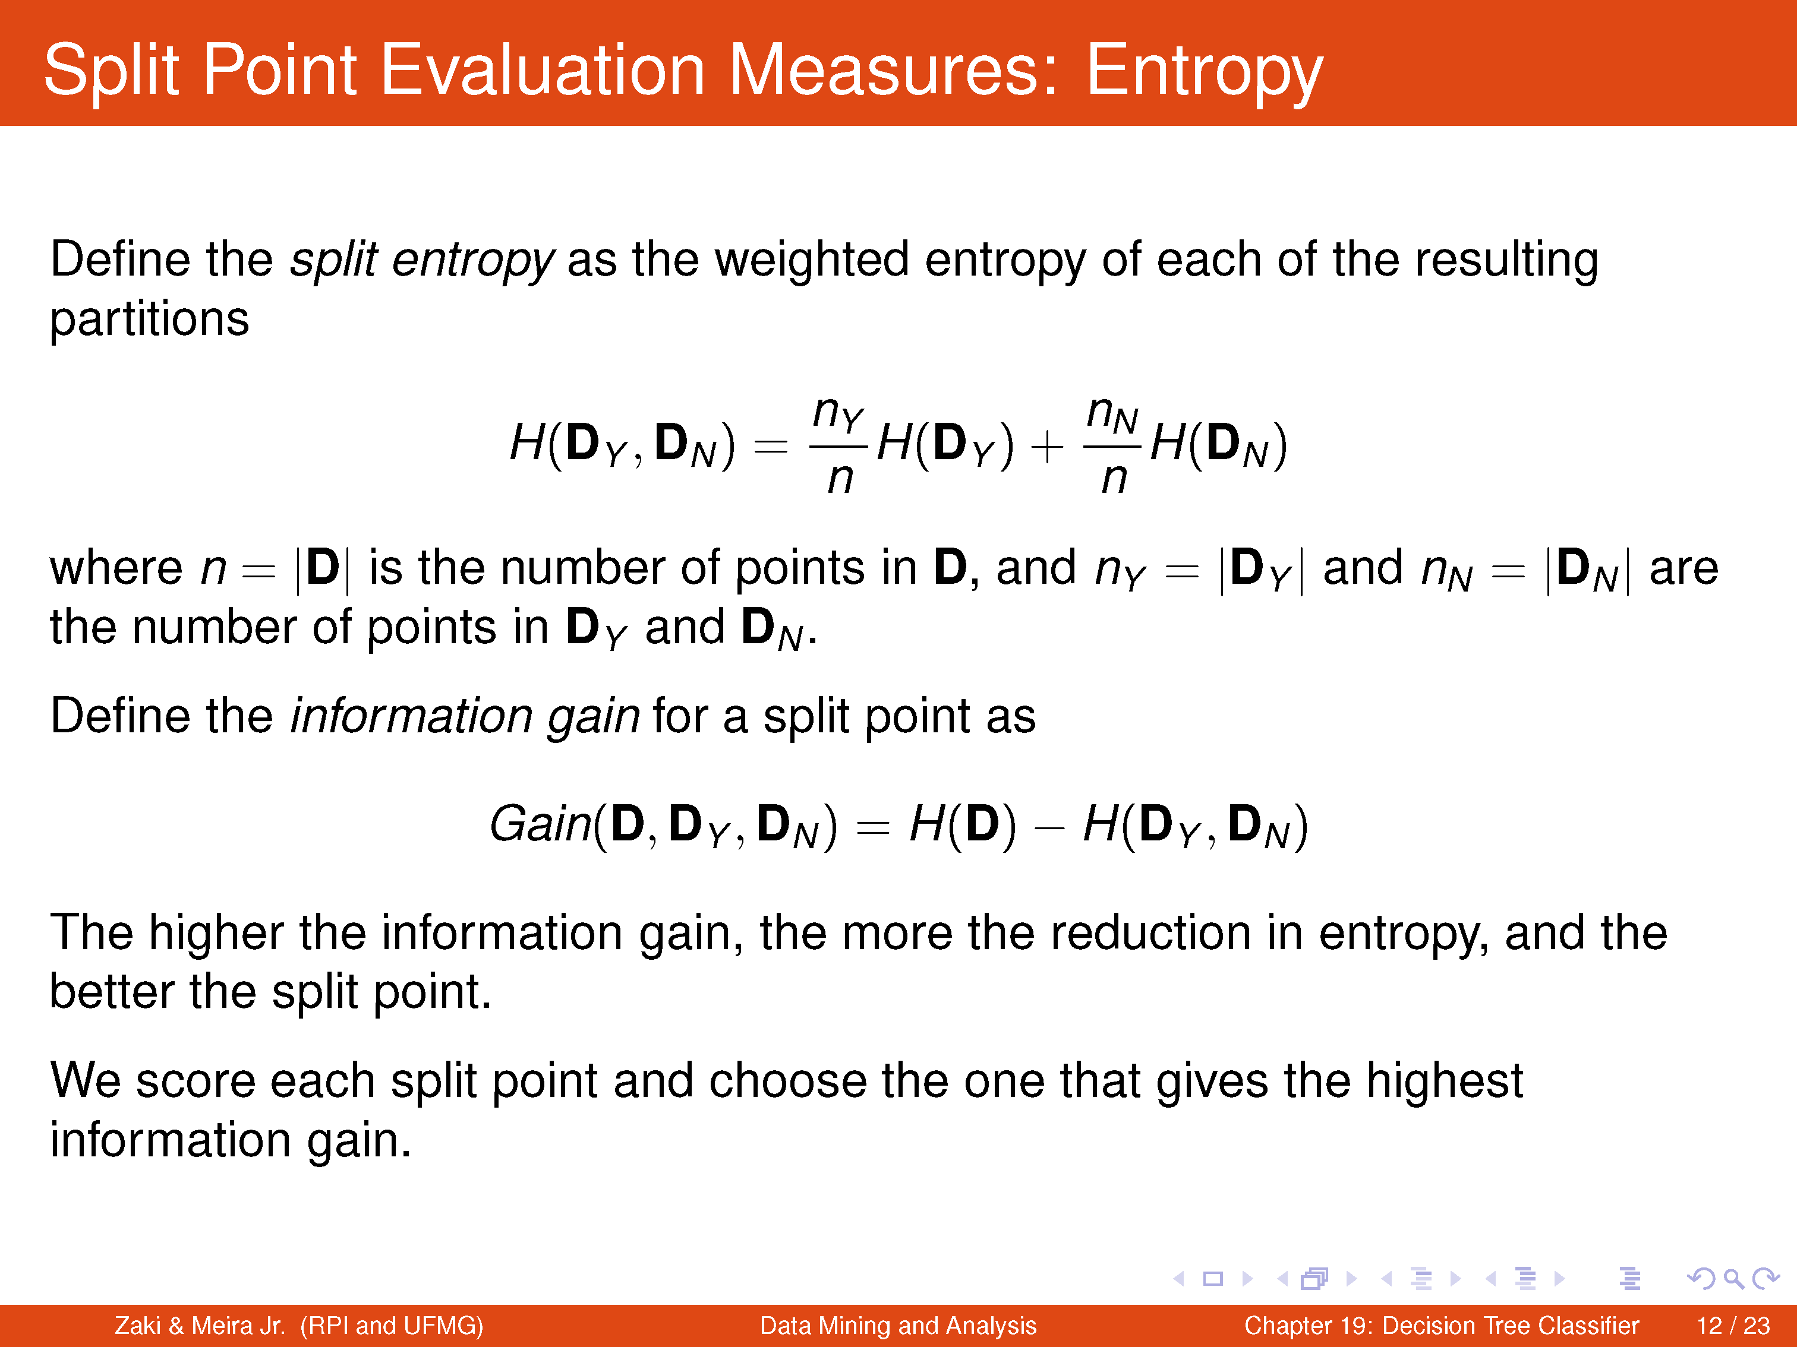

Slide 20
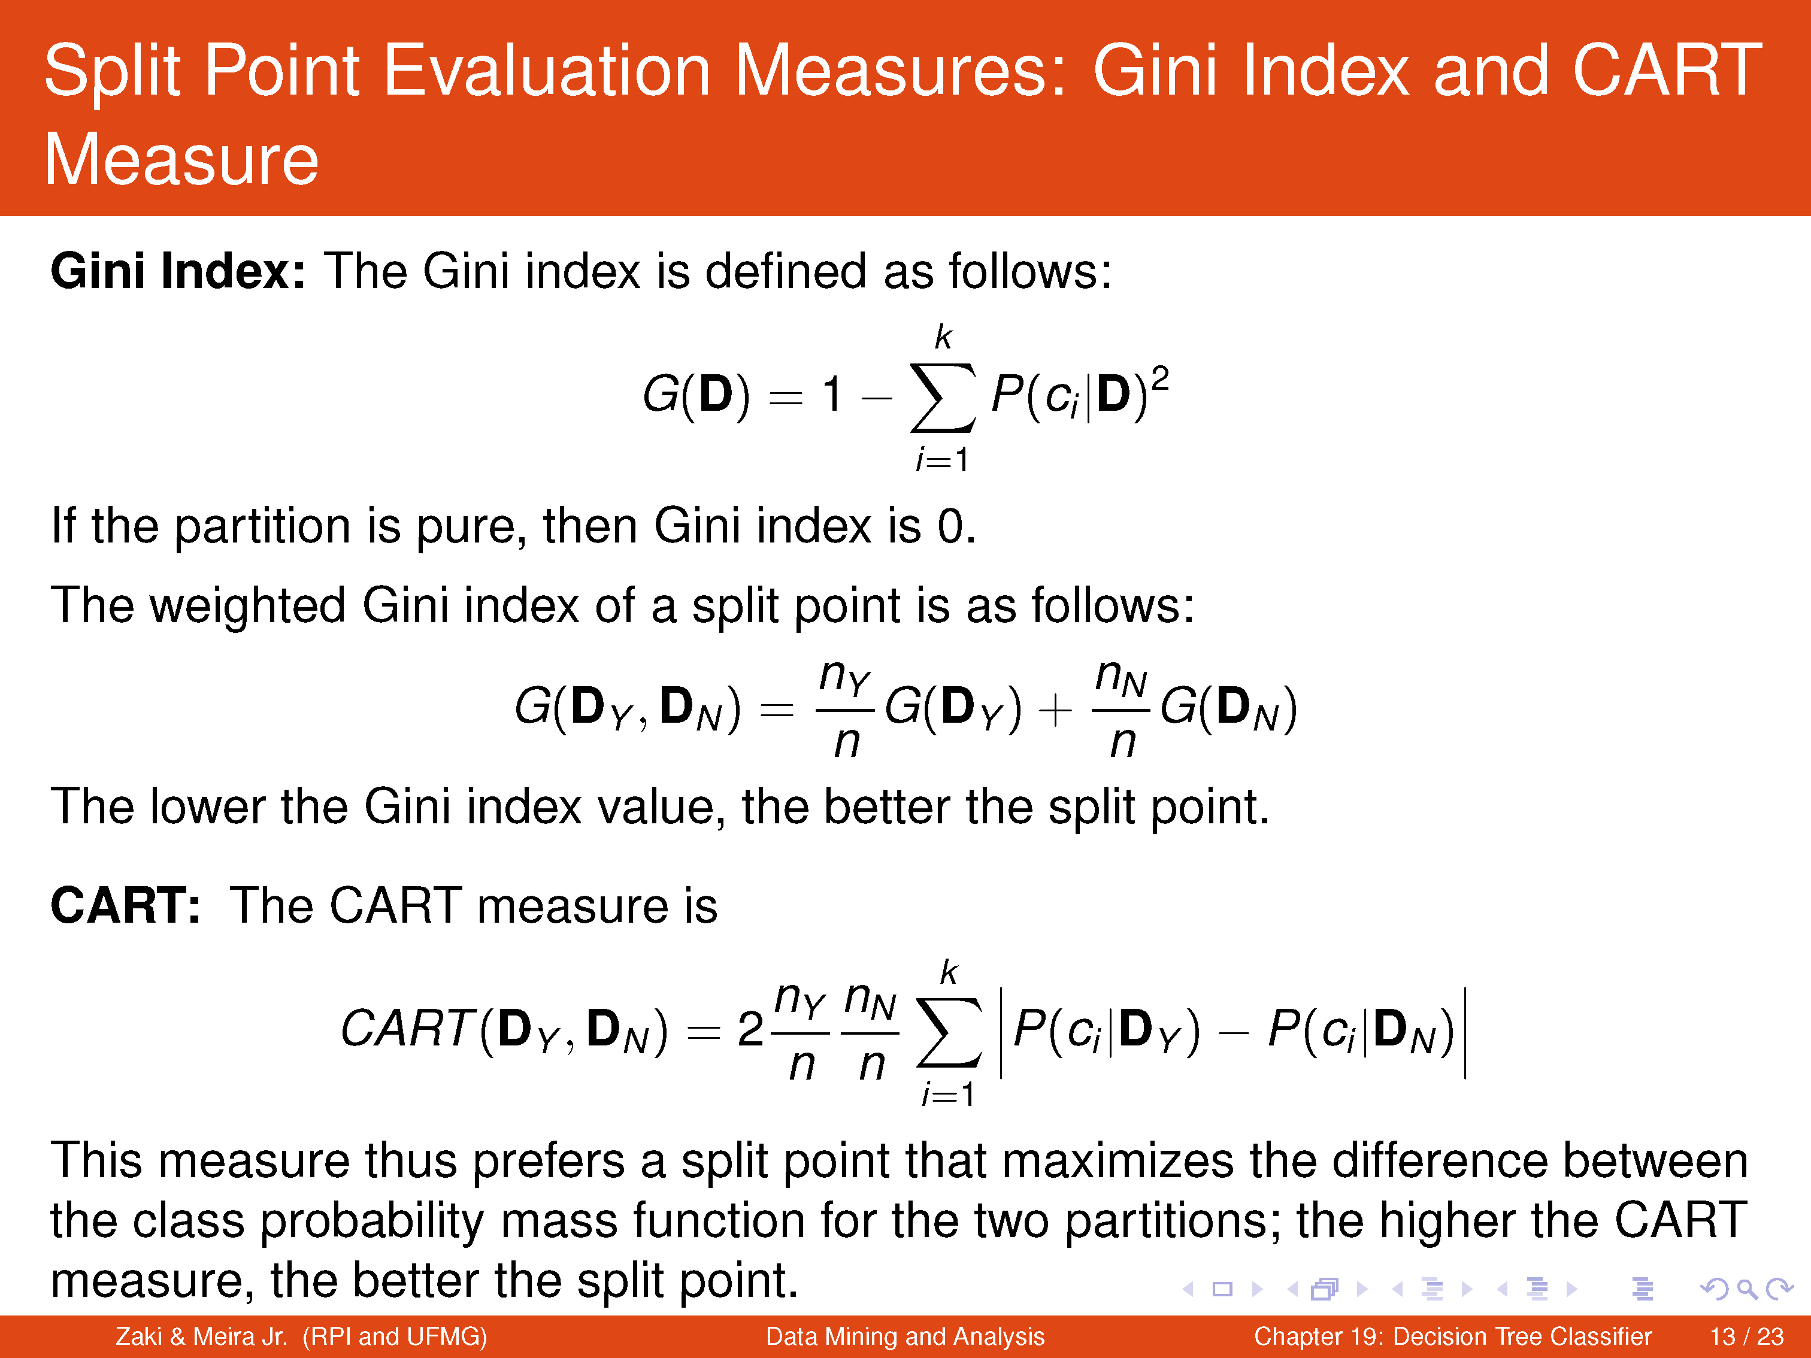

Slide 21
Slides belongs to Dr. Wil Van Der Aalst

Slide 45
Reading materials
Chapter 19: Decision Tree Classifier. Data Mining and Analysis: Fundamental Concepts and Algorithms Mohammed J. Zaki, Wagner Meira Jr. http://www.dataminingbook.info/pmwiki.php/Main/BookResources
Decision Tree Classifier. Scikit-learn. https://scikit-learn.org/stable/modules/generated/sklearn.tree.DecisionTreeClassifier.html

